Slide 1
Data Tales 2023
Brief Overview
IPL Dasboard

Slide 2
Team – Insight Innovators
Team Members:
Sakshi Bidwai
Laxmi Kurapati
Vivek Gogi
Problem Statement – IPL Dashboard

Slide 3
Context
Problem Statement
Team-wise IPL Stats
Player-wise IPL Stats
Match-wise IPL Stats
Formation IPL Team Based On Insights

Slide 4
Problem Statement
You are a Sports Analyst who specializes in Cricket. As the IPL mega auction 2018 is near and every team will start afresh with a new combination of players, you are being hired by the XYZ IPL team to help them with the best insights and give them an edge in the tournament. You have been provided with some data files which contain data(IPL 2013-2017) about the following:
Ball by Ball details of every match
Player Profile
Match details
Playing XI details
Teams and their IDs
You are required to analyze the dataset and come up with key insights using any data visualization as your team owners will only have time to see the dashboard you create and make decisions on the basis of that. You are free to use your own metrics and come up with a viable strategy.

Slide 5
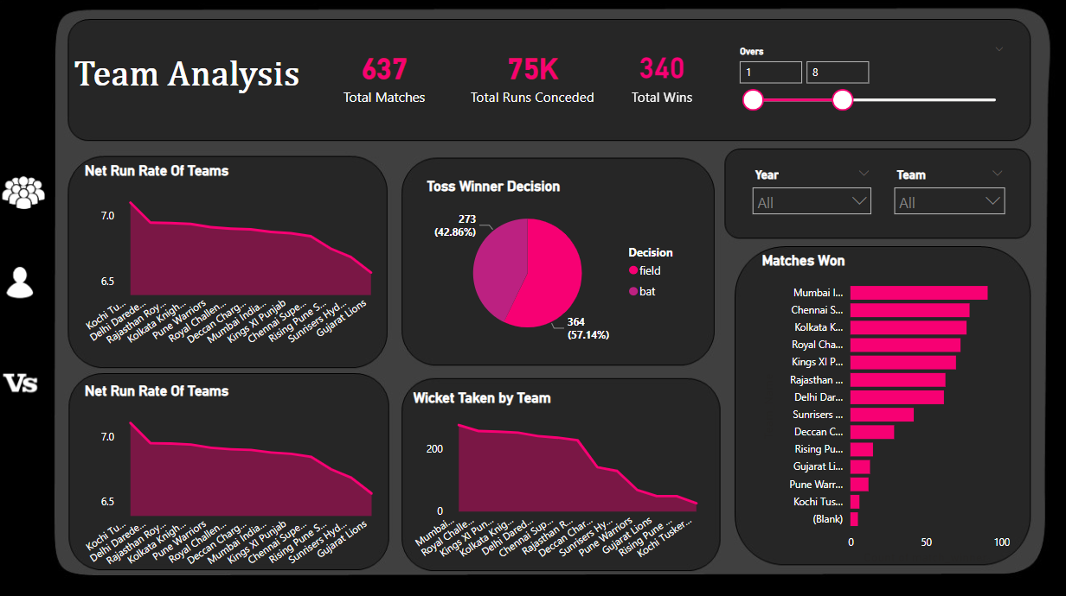
Team-wise IPL Stats

Slide 6
Team-wise IPL Stats
Key Takeaways from Team Analysis:
The Net Run Rate of a team can give insights into the consistency of their performance throughout the tournament. Teams with a high net run rate are more likely to have won matches by large margins, indicating a consistent and dominant performance.
The number of matches won can give insights into the overall performance of the team throughout the tournament. Teams with a higher number of wins are more likely to have performed consistently and have a better chance of reaching the playoffs.
Teams may choose to bat first on a pitch that is likely to deteriorate over time, making it difficult for the chasing team. Alternatively, teams may choose to field first on a pitch that is likely to assist the bowlers early on.
Teams that have a strong batting line-up may choose to bat first to set a high target, while teams with strong bowling may choose to field first to restrict the opposition to a low score.
The number of wickets taken by a team can provide insights into their bowling performance throughout the tournament. Teams with a higher number of wickets taken are likely to have a strong and effective bowling attack.

Slide 7
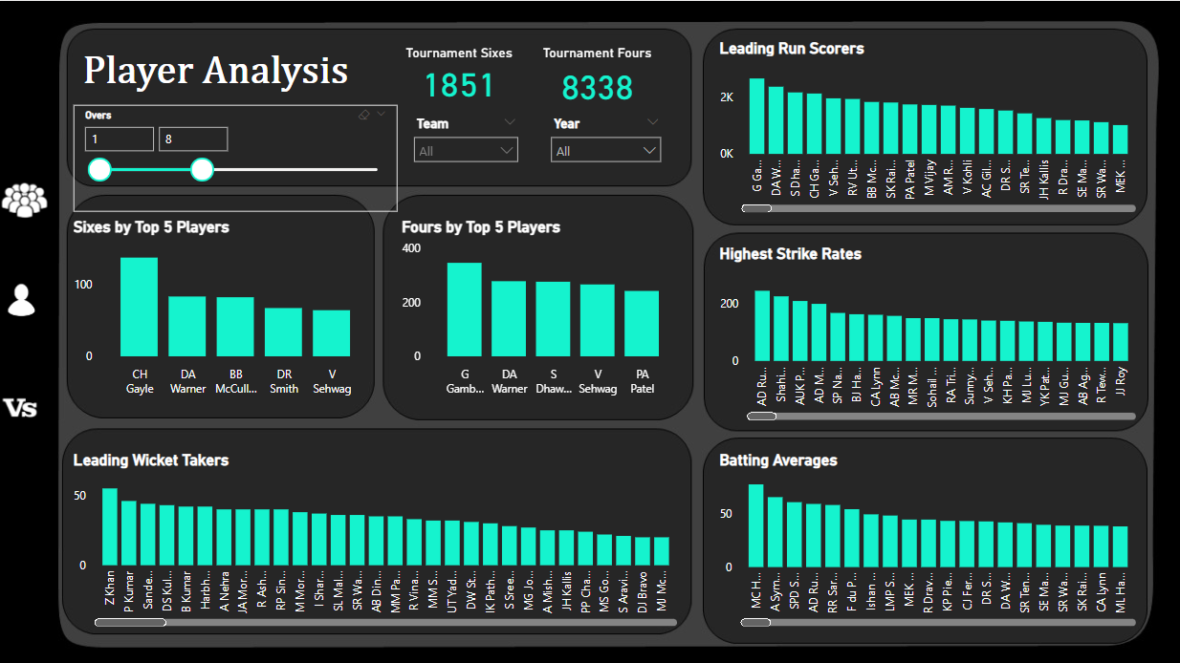
Player-wise IPL Stats

Slide 8
Player-wise IPL Stats
Key Takeaways from Player Analysis:
Looking at the leading run-scorers across multiple seasons can help identify the most consistent and reliable batsmen in the tournament. Players who consistently feature in the list of leading run-scorers are likely to be the most consistent performers in the tournament. These players are likely to be highly sought after in team auctions and can be valuable assets to any team.
By looking at the batting averages of players across multiple seasons, you can identify the players who consistently perform well and are likely to be reliable performers for their teams. The higher the batting average, the more consistent and impactful the player is likely to be.
If a team has several players with high strike rates, it may indicate that the team is following an aggressive batting strategy. Players with a high strike rate are likely to be more aggressive and may prefer to play attacking shots, while players with a lower strike rate may be more defensive and focus on building an inning.
Leading wicket-takers are likely to have played a vital role in their team's success by taking wickets at crucial moments. They may be key to winning matches and can be important assets in a team's bowling line-up.
The number of sixes hit by a player is a good indicator of their power-hitting abilities. Team owners can use this information to identify and select players who can consistently hit sixes and score quick runs and they may opt for a more aggressive batting approach.
The number of fours hit by a player in a match can indicate their impact on the team's score. A player who hits a large number of fours in a short period can quickly increase the team's total score and put pressure on the opposition.

Slide 9
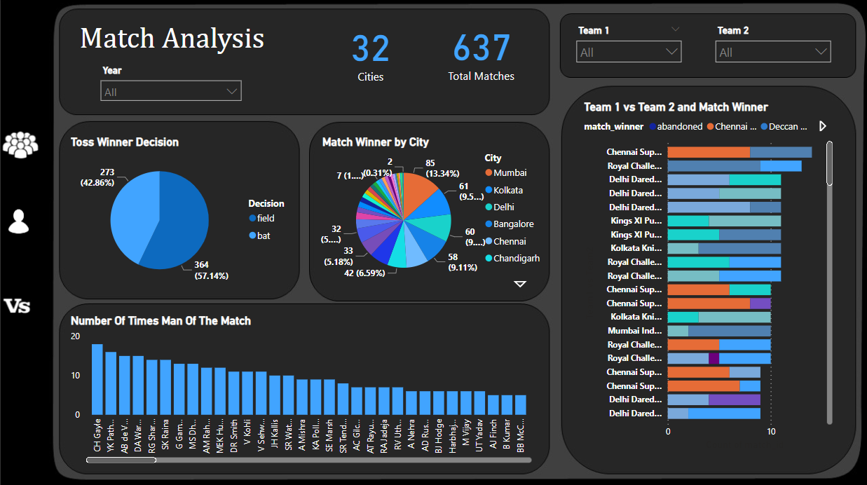
Match-wise IPL Stats

Slide 10
Match-wise IPL Stats
Key Takeaways from Match Analysis:
Analyzing the match outcome based on the toss winner decision can provide insights into the impact of the decision on the match outcome. It can help teams to evaluate the effectiveness of their strategy and make adjustments for future matches.
Playing in the home ground can provide a significant advantage to the home team, as they are familiar with the ground conditions and have the support of the home crowd. he home ground of a team may have unique pitch conditions that are different from other grounds.
Analyzing the number of times a player has been awarded the "Man of the Match" title can provide valuable insights into their performance, impact on team success, key strengths, and consistency. This can help teams to make informed decisions about player selection and strategy in future matches.
Here in the Match Analysis, By analyzing the relationship between Team 1, Team 2, and the Match Winner can provide valuable insights into team performance, home advantage, team strategy, and individual player performance. These insights can help teams to make informed decisions about player selection, team strategy, and tactics for future matches.

Slide 11
Formation IPL Team Based On Insights
Team:
Based on the above strategies, I have come up with the following team Formation of a team for IPL Tournament:
Batsmen: Rohit Sharma, Shikhar Dhawan, David Warner, Virat Kohli (C), Kane Williamson (Overseas), M S Dhoni (WK), and Rishabh Pant (WK).
All-rounders: Hardik Pandya, Ravindra Jadeja, and Glenn Maxwell (Overseas).
Bowlers: Jasprit Bumrah, Bhuvneshwar Kumar, R Ashwin, Trent Boult (Overseas), and Rashid Khan (Overseas).

Slide 12
Formation IPL Team Based On Insights
Justification:
The team composition includes a mix of experienced and young players, with Virat Kohli leading the team.
The batting lineup includes top Indian batsmen as well as Overseas Batsmen like Rohit Sharma, Shikhar Dhawan, David Warner, Virat Kohli (C), Kane Williamson (Overseas), and M S Dhoni (WK). who have a good track record in the IPL.
The all-rounders include Hardik Pandya, who is known for his big hitting and excellent fielding, Ravindra Jadeja, who is a handy left-arm spinner and a good fielder, and Glenn Maxwell, who is an experienced overseas player known for his spin bowling and big hitting.
The bowling lineup includes some of the best Indian pacers like Jasprit Bumrah, Bhuvneshwar Kumar, Mohammed Shami for power plays and death overs, and two overseas players - Trent Boult and Rashid Khan. Boult is an experienced overseas pacer who can swing the ball and take early wickets, while Rashid Khan is an experienced leg-spinner who can take wickets in the middle overs and restrict the opposition from scoring quickly.

Slide 13
Thank You

